Slide 1
UE19CS345 – Network Analysis and Mining
Course Project
Project Title : Eurovision Network Analysis
Team member 1 SRN and name: Bhoomika Bhavimath – PES2UG19CS091
Team member 2 SRN and name: Deepali Attavar - PES2UG19CS106
Team member 3 SRN and name: Deepthi B - PES2UG19CS107
Team member 4 SRN and name: Lasya Priya - PES2UG19CS111
Collab notebook link:
https://colab.research.google.com/drive/1xSDIaf26Z2NNdu9U2AIywDFogwvQdCJQ?usp=sharing

Slide 2

Topic and its uniqueness
The Eurovision Song Contest is a song contest run by the European Broadcasting Union that started in 1956. Different singers representing countries in Europe compete every year.
Our comprised of all music enthusiasts
we felt it was only right to do our project
related to the music world. We found
Right source for dataset in data.world.com and decided to do analyse eurovision network.

Slide 3
Problem statement
The dataset consists of the votes by different sources. We chose Eurovision dataset as it contains metadata, contest ranking and voting data of the songs that have competed in the Eurovision Song Contests. Every year, this dataset is updated with the result of the contest .Using this dataset we wanted to build a network analysis to understand the contest between each country and their participation in this contest.
As it contains data of different countries it would be suitable to describe as a network graph and visualize it .
The main aim is to analyze the Eurovision data set to collect the information about the votes (by-and-to) for different countries and study the network formed using various techniques.
We also focus on finding different types of votes acquired by the participating countries i.e., the countries that were voted by its neighboring and non-neighboring countries.

Slide 4
Initial approach
The downloaded dataset is uploaded onto the ipynb notebook. Through this project, we aim to build and visualize the Eurovision dataset and also gain a better understanding about the structure and relations between different countries in this dataset by analyzing the network using the Python networkX package.
Basic preprocessing is done using pandas package including removal of unnecessary data and normalizing it.
Visualizations are made using pyplot package.
Finally, cycle detection is done to detect cycles in the graph.

Slide 5
Dataset
Data set contains all scores given from 1975 till 2019 during finals and semi-finals. For last years split between Jury-voting and Tele-voting.
Be aware countries change over time (ie FYR Macedonia became North Macedonia in 2019). Also note that in a given year more countries can vote than participate in a (semi) finale.

Slide 6
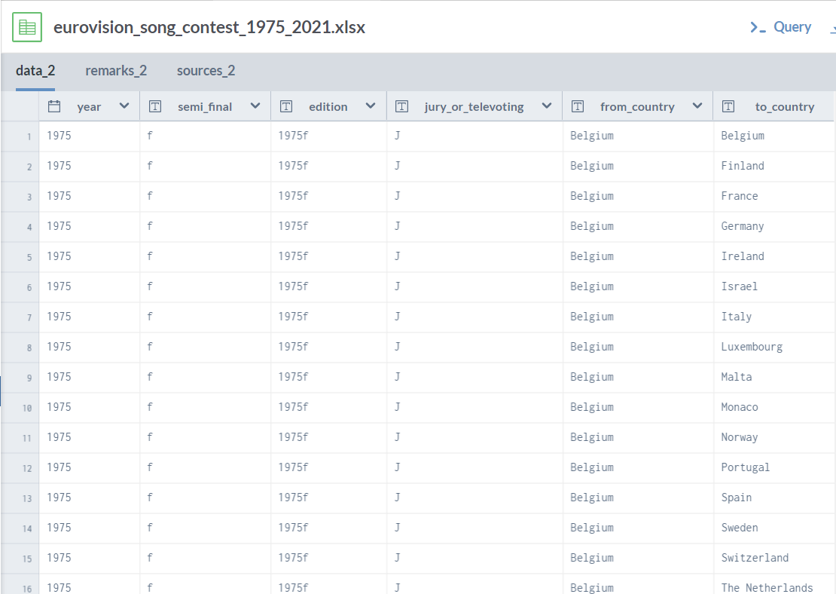

Slide 7
Project Description
We are using various graph analytics techniques to help visualize our problem statement.
Performed:
Data cleaning and visualisation based on country
Extracted the winners in various years
Found countires that were top for 3, 5, 7, 10 yrs
Visualised the type of vote various counties got: Jury or TeleVote through a bar graph (Conc)
Visualised the directed graph generated based on countries televoting for other countries by aggregating votes from country u to v. Also visualised the graph with 30% of this aggregated weight to get the top countries voted by a country. The outdegrees are normalised.
The node measures: pagerank, eigenvector, degree, betweenness, closeness, and pond; are calculated for the countries.
The countries' egonetworks are visualised.

Slide 8
Final results
Slide number | Content
1 | Stacked bar chart depicting points earned by countries by votes from other countries (Sweden and Iceland)
2 | Stacked bar chart depicting points earned by countries by votes from other countries (United Kingdom)
3 | Graph visualization of the dataset to see connectivity (with and without weighted edges)
4 | Summary of basic centrality measures of each country of the dataset
5 | Sample visualization of egocentric network from the dataset
6 | Hybrid bar chart showing frequency of occurrence of certain countries in top positions of the competition

Slide 9
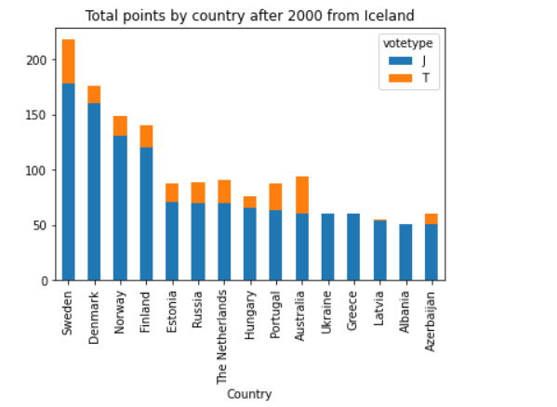
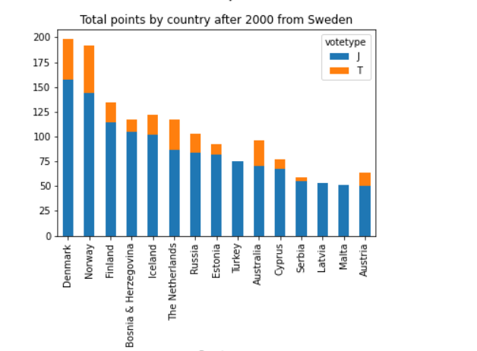

Slide 10
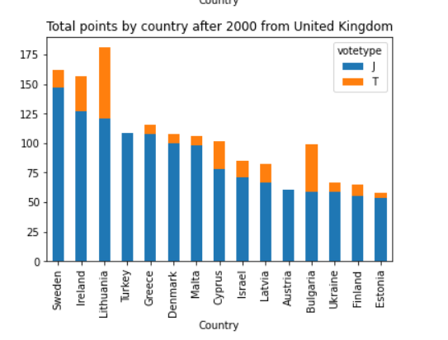

Slide 11
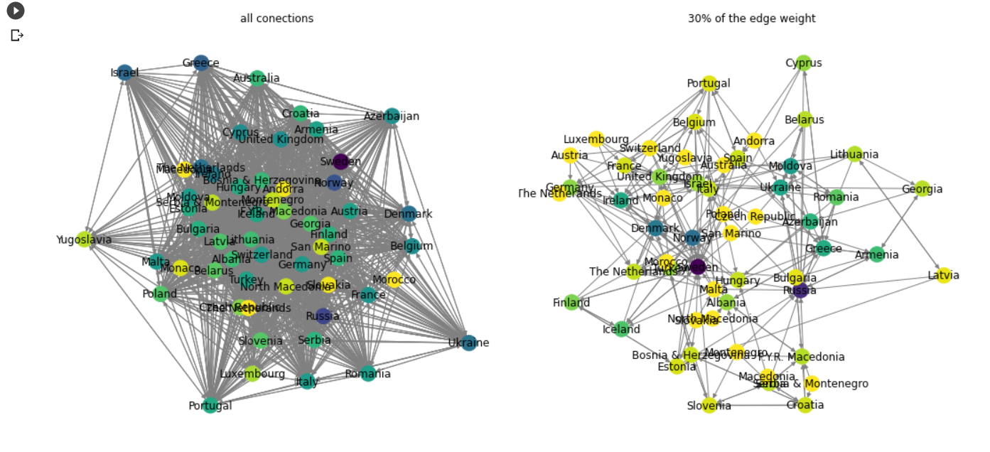

Slide 12
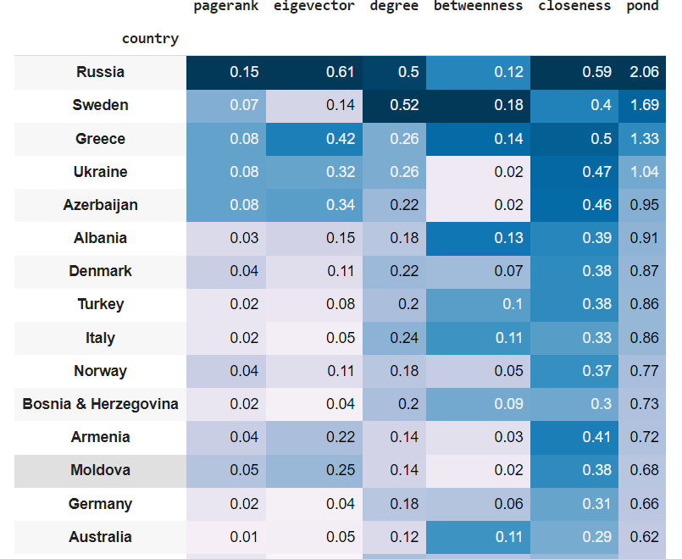

Slide 13
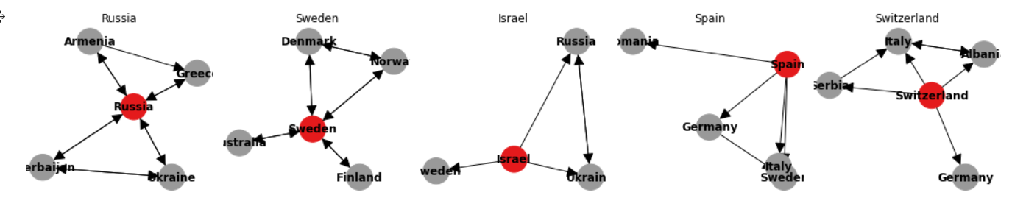
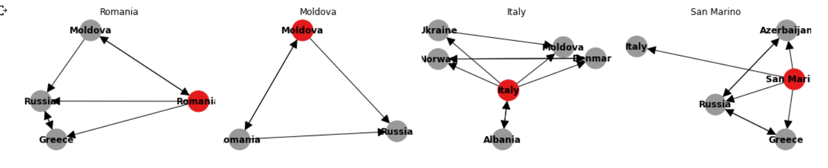

Slide 14
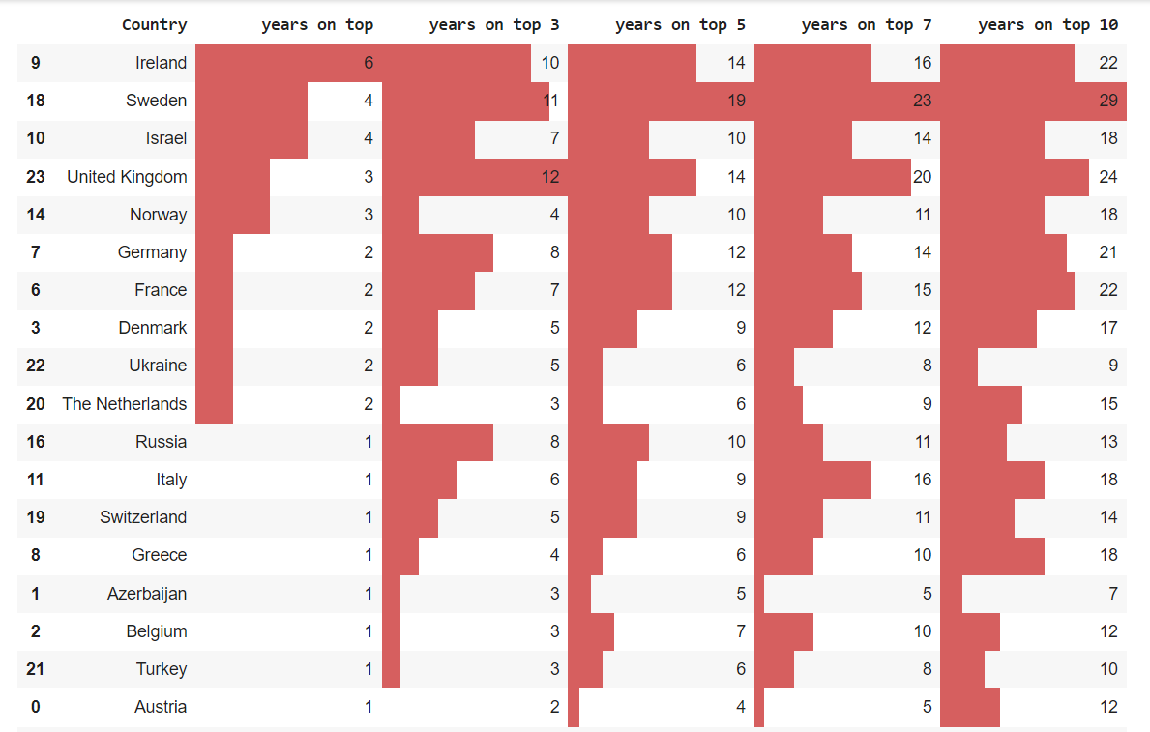

Slide 15
Quantity and quality of work
no | Code functionality | % Complete | Runs without problem (Y/N) | If there are minor issues, indicate
1 | To find the top country by points | 100% | yes | -
2 | To find correlation between various network analysis metrics | 100% | yes | -
3 | Cycle detection for directed graph | 100% | yes | -
4 | To find the egocentricity among nodes | 100% | yes | -

Slide 16
Top few learning
Serial No | Top learning in this project
1 | Some countries seem to concentrate their votes on specific partners and other countries never votes on their neighbours.
2 | We clearly see that Iceland has given most of its high votes to its neighbours.
3 | The Jury can influence more the result than the public (Televote) and, in many cases, is clear the diference on their preference.
4 | The UK is the most notable runner-up in history

Slide 17
Top unresolved challenges
Serial No | Brief description of unresolved challenges | Type of challenge (scope/data/design/implementation / others)
1 | Community detection could not be implemented on this dataset since the dataset was a directed one | implementation

Slide 18
Reference papers, if any
No | Paper Title | Authors
1 | The Eurovision Song Contest as a ‘Friendship’ Network | Anthony Dekker, Australian Defence Science and Technology Organisation (DSTO)
2 | Network Analysis -Eurovision Dataset | Mohammed Yahya

